Slide 1

RETAIL SALES DATA ANALYSIS AND PREDICTION
NIVETHA ESWARAN

Slide 2
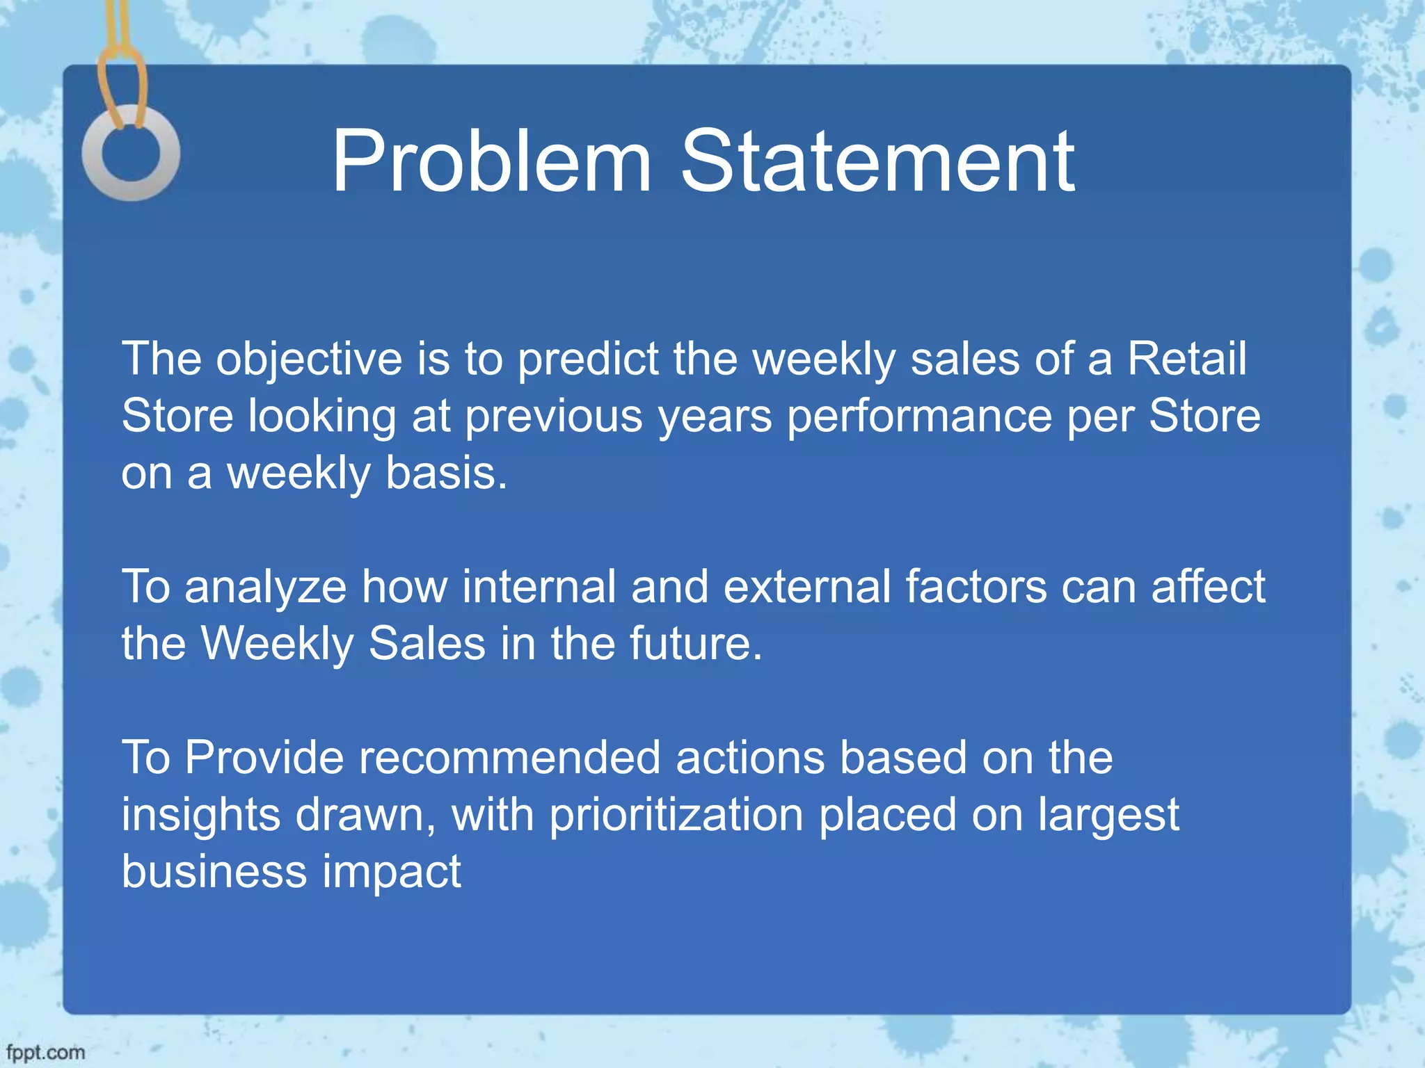

Slide 3
DATASET INFORMATION
Dataset consists of the several variables providing information about the sales with more than 418709 rows and 20 columns in the data.
This is also the most vital set of information which would be used to segregate for train test split function later in order to check the accuracy.
DATA UNDERSTANDING:
Dataset consists of the several variables providing information about the sales.
Independent Variables:
Numerical Columns – 17
Categorical Columns ----3

Slide 4
INDEPENDENT VARIABLE
STORE -TOTAL 45 STORES INT
DEPARTMENT -TOTAL 81 DEPARTMENT INT
TEMPERATURE -TEMPERATURE OF THE AREA FLOAT
FUEL PRICE -FUEL PRICE OF THE AREA FLOAT
TYPE -TYPES OF STORES(A,B,C) OBJECT
SIZE -SIZE OF THE STORE INT
MARKDOWN VARIOUS FACTORS AFFECTING SALES FLOAT
CPI(CONSUMER PRICE INDEX) AVERAGE CHANCE OF CUSTOMERS BUYING FLOAT
THE GOODS
DATE DATE OF PURCHASE DATE/TIME
UNEMPLOYMENT UNEMPLOYMENT RATE IN THE AREA OF
STORE FLOAT
IS_HOLIDAY HOLIDAY DETAILS BOOLEAN

Slide 5
DEPENDENT VARIABLE:
WEEKLY_SALES: (TARGET) SALES OF THE STORES FLOAT

Slide 6
DATA PRE-PROCESSING
We checked for the dtypes of the dataset and found that the date time column is in object so we changed that column dtype as datetime.
Checking NULL VALUES and NAN Values in the dataset
Grouped by Dept and calculated summary statistics for Weekly sales.
Removed negative values in the data set as sales cannot have negative values.
Checking all the unique values.
From checking null values it is inferred that Markdown columns are having more Nan values . So its is dropped from the df for further Analysis.

Slide 7
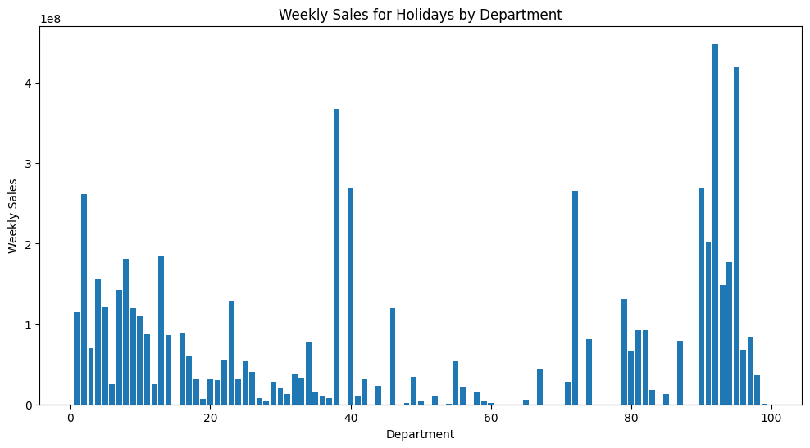
EXPLORATORY DATA ANALYSIS (EDA):

Slide 8
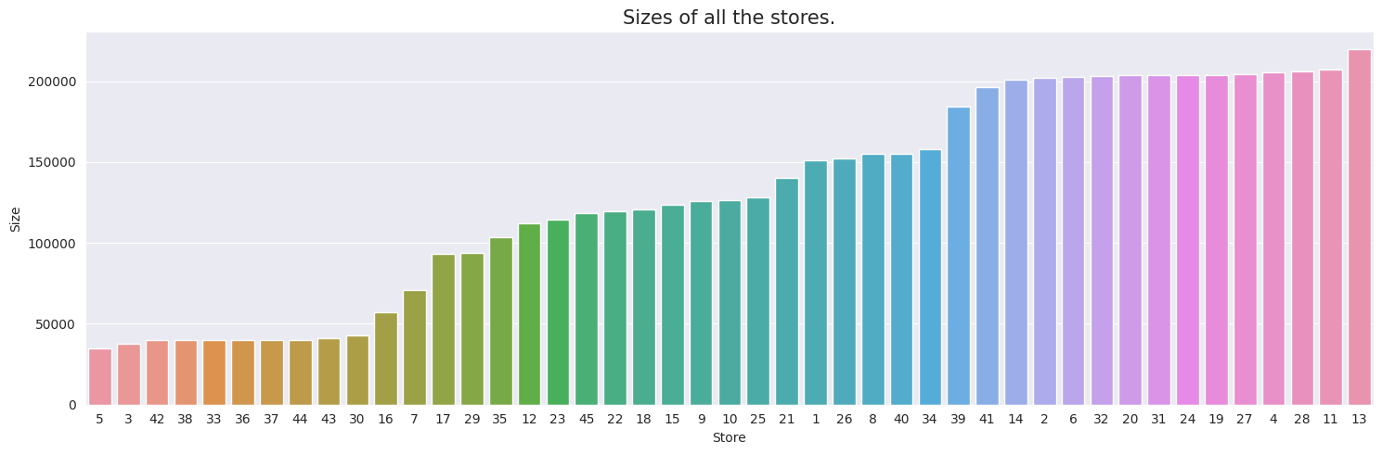
There are broadly 3 types of stores: small-sized, medium-sized and large-sized.
This numerical variable can be converted into categorical variable
Size of the type of stores are consistent with sales, as expected.
Higher size stores has higher sales. And, Walmart classify stores according to their sizes according to graph.
After the smallest size value of Type A, Type B begins. After the smallest size value of Type B, Type C begins.

Slide 9
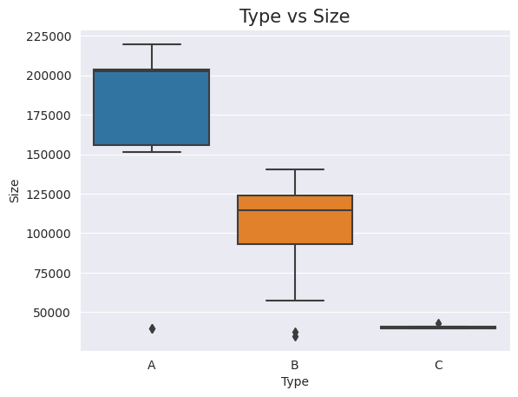
we can see from the graph that it covers the effect of size column.
A type are large in size
B type are medium in size
C type are less in size

Slide 10
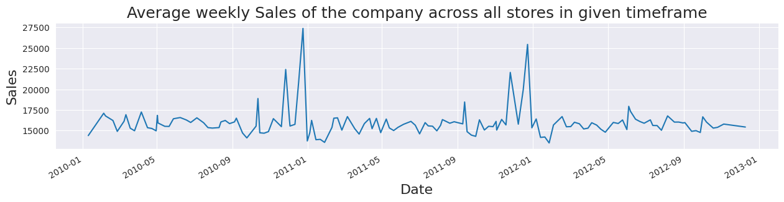

Slide 11
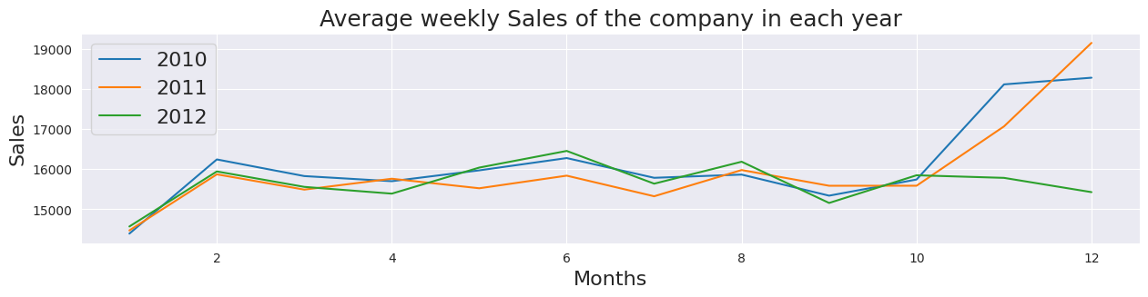

Slide 12
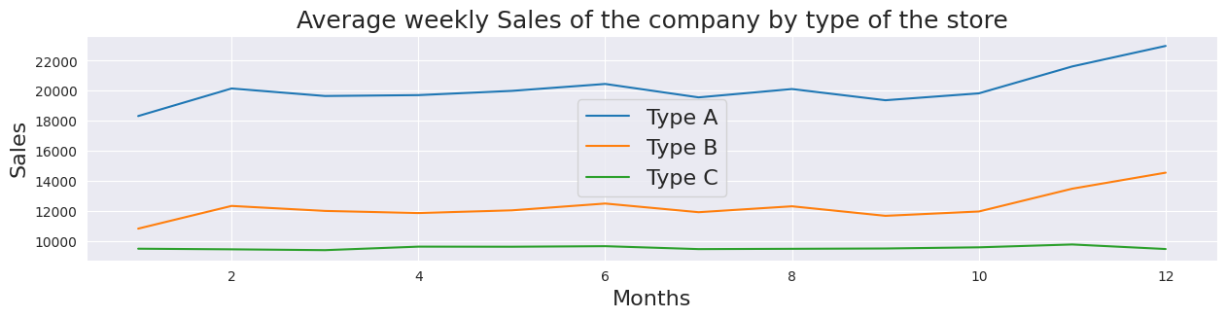

Slide 13
Sales of the company rise during the end of the year.
Possible reasons could be any tradition or festival in that company.
Type A stores seem to have comparitively high sales. But this can be due to difference in number of stores of different type. Also, we can notice that sales of type C are constant over the year.

Slide 14
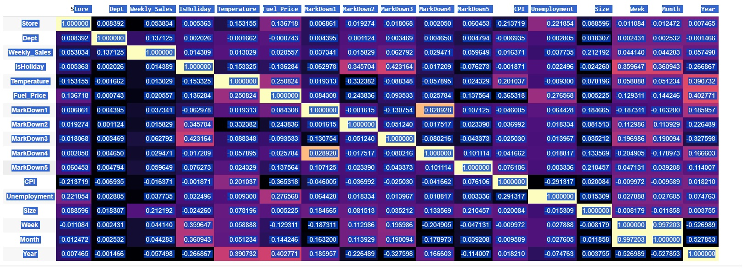

Slide 15
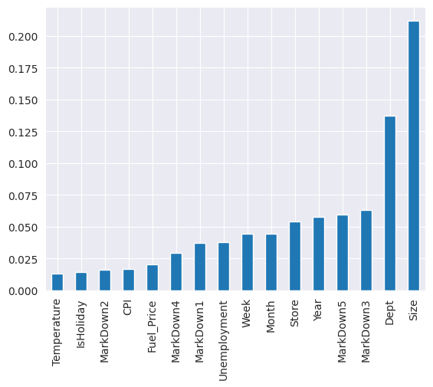
It seems the features 'Dept'and 'Size' have 13% and 21% correlation with Weekly sales. The contribution of other features are comparatively low

Slide 16
The bar plot confirms our findings, but the distribution of target variable is highly skewed. That's why, I will not go with linear regression

Slide 17
MODEL BUILDING :
Model testing
Using all features
Using best contributing features(Store, Department and Size)
ALGORITHMS USED:
Decision Tree Regressor
Random Forest Regressor
XGB Regressor
Kneighbors Regressor

Slide 18
DecisionTreeRegressor
score
MAE | 2561.394139
R2 score | 0.930296
KNeighborsRegressor
score
MAE | 5882.091396
R2 score | 0.757022
RandomForestRegressor
 | score
MAE | 2291.969227
R2 score | 0.94599
XGBRegressor
score
MAE | 3098.864809
R2 score | 0.936488

Slide 19
Using Store, Department and Size columns
DecisionTreeRegressor
XGBRegressor
score
MAE | 2662.665531
R2 score | 0.916865
score
MAE | 3184.626212
R2 score | 0.90925
RandomForestRegressor,
score
MAE | 2663.467588
R2 score | 0.916861
KNeighborsRegressor
score
MAE | 2961.247316
R2 score | 0.897378

Slide 20
RandomForestRegressor using all features gives the best result. So cross-validation and Hyper parameter tuning is done on this model to get the final prediction
Cross-validation
Hyper parameter tuning
Fitting 4 folds for each of 10 candidates, totalling 40 fits 0.769010856715636 {'n_estimators': 60, 'min_samples_split': 4, 'min_samples_leaf': 1, 'max_features': 3, 'max_depth': 35}
## cross-validation using kfold
Fold: 1 Fold: 2 Fold: 3 Fold: 4 R2 - CV Score: 0.9416820312258074 MAE Score: 2313.0422350210597 Score : [0.9401119559952887, 0.9449790361081322, 0.9351858883626516, 0.9464512444371572

Slide 21
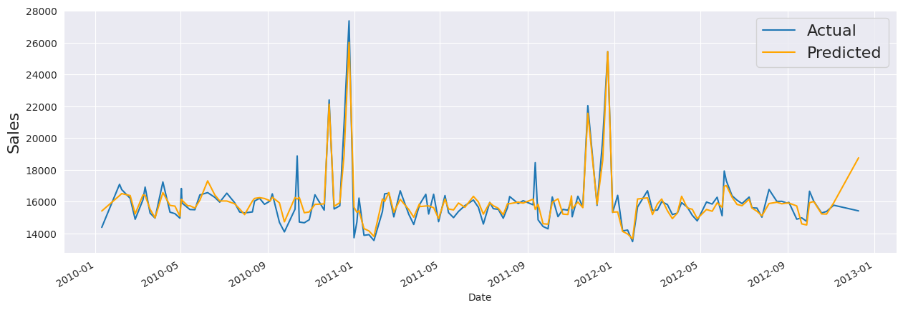

Slide 22
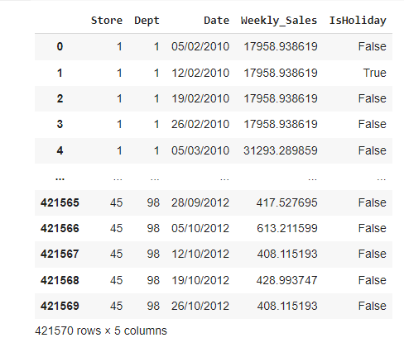
Making final predictions

Slide 23
effects of markdowns on holiday weeks
Our model performs well without Markdown . As most of the Markdown data’s are null , it cannot be taken as importance features.
Our model works well with Random forest Regressor with 97 %accuracy
R2 score: 2663.467
MAE score: 91. 68%
Best features taken are stores, department and size.

Slide 24
recommended actions based on the insights drawn, with prioritization placed on largest business impact
Optimize Holiday-Specific Promotions:
Sales in the months of December and November is comparitively high as these are festival season and winter vacations!
From the correralation we understand that there is high correlation between year with fuel price, temperature. Which says that everyyear fuel and temperature increases which can indirectly the sales.
If the type A stores are increased there can be significant changes in retail sales as type A is large in size and it can have many departments in the store if the size is more which automatically increases sales.
If the Unemployment rate is more weekly sales is affected as CPI will also become less.
These factors when changed or improved can have large business impact in the area.

